Slide 1
The past, present, and future history of quantum computing
Dr. Bhawana Rudra
NITK
Slide 1/29

Slide 2
Quantum computing
A quantum computer is a machine designed to use the principles of quantum mechanics to do things which are fundamentally impossible for any computer which only uses classical physics.
Slide 2/29

Slide 3
Quantum computing
A quantum computer is a machine designed to use the principles of quantum mechanics to do things which are fundamentally impossible for any computer which only uses classical physics.
This lecture will discuss the history of quantum computing, including:
The basic concepts behind quantum mechanics
How we can use these concepts for teleportation and cryptography
Quantum algorithms outperforming classical algorithms
Experimental implementations of quantum computing
Commercialisation of quantum technologies
Slide 2/29

Slide 4
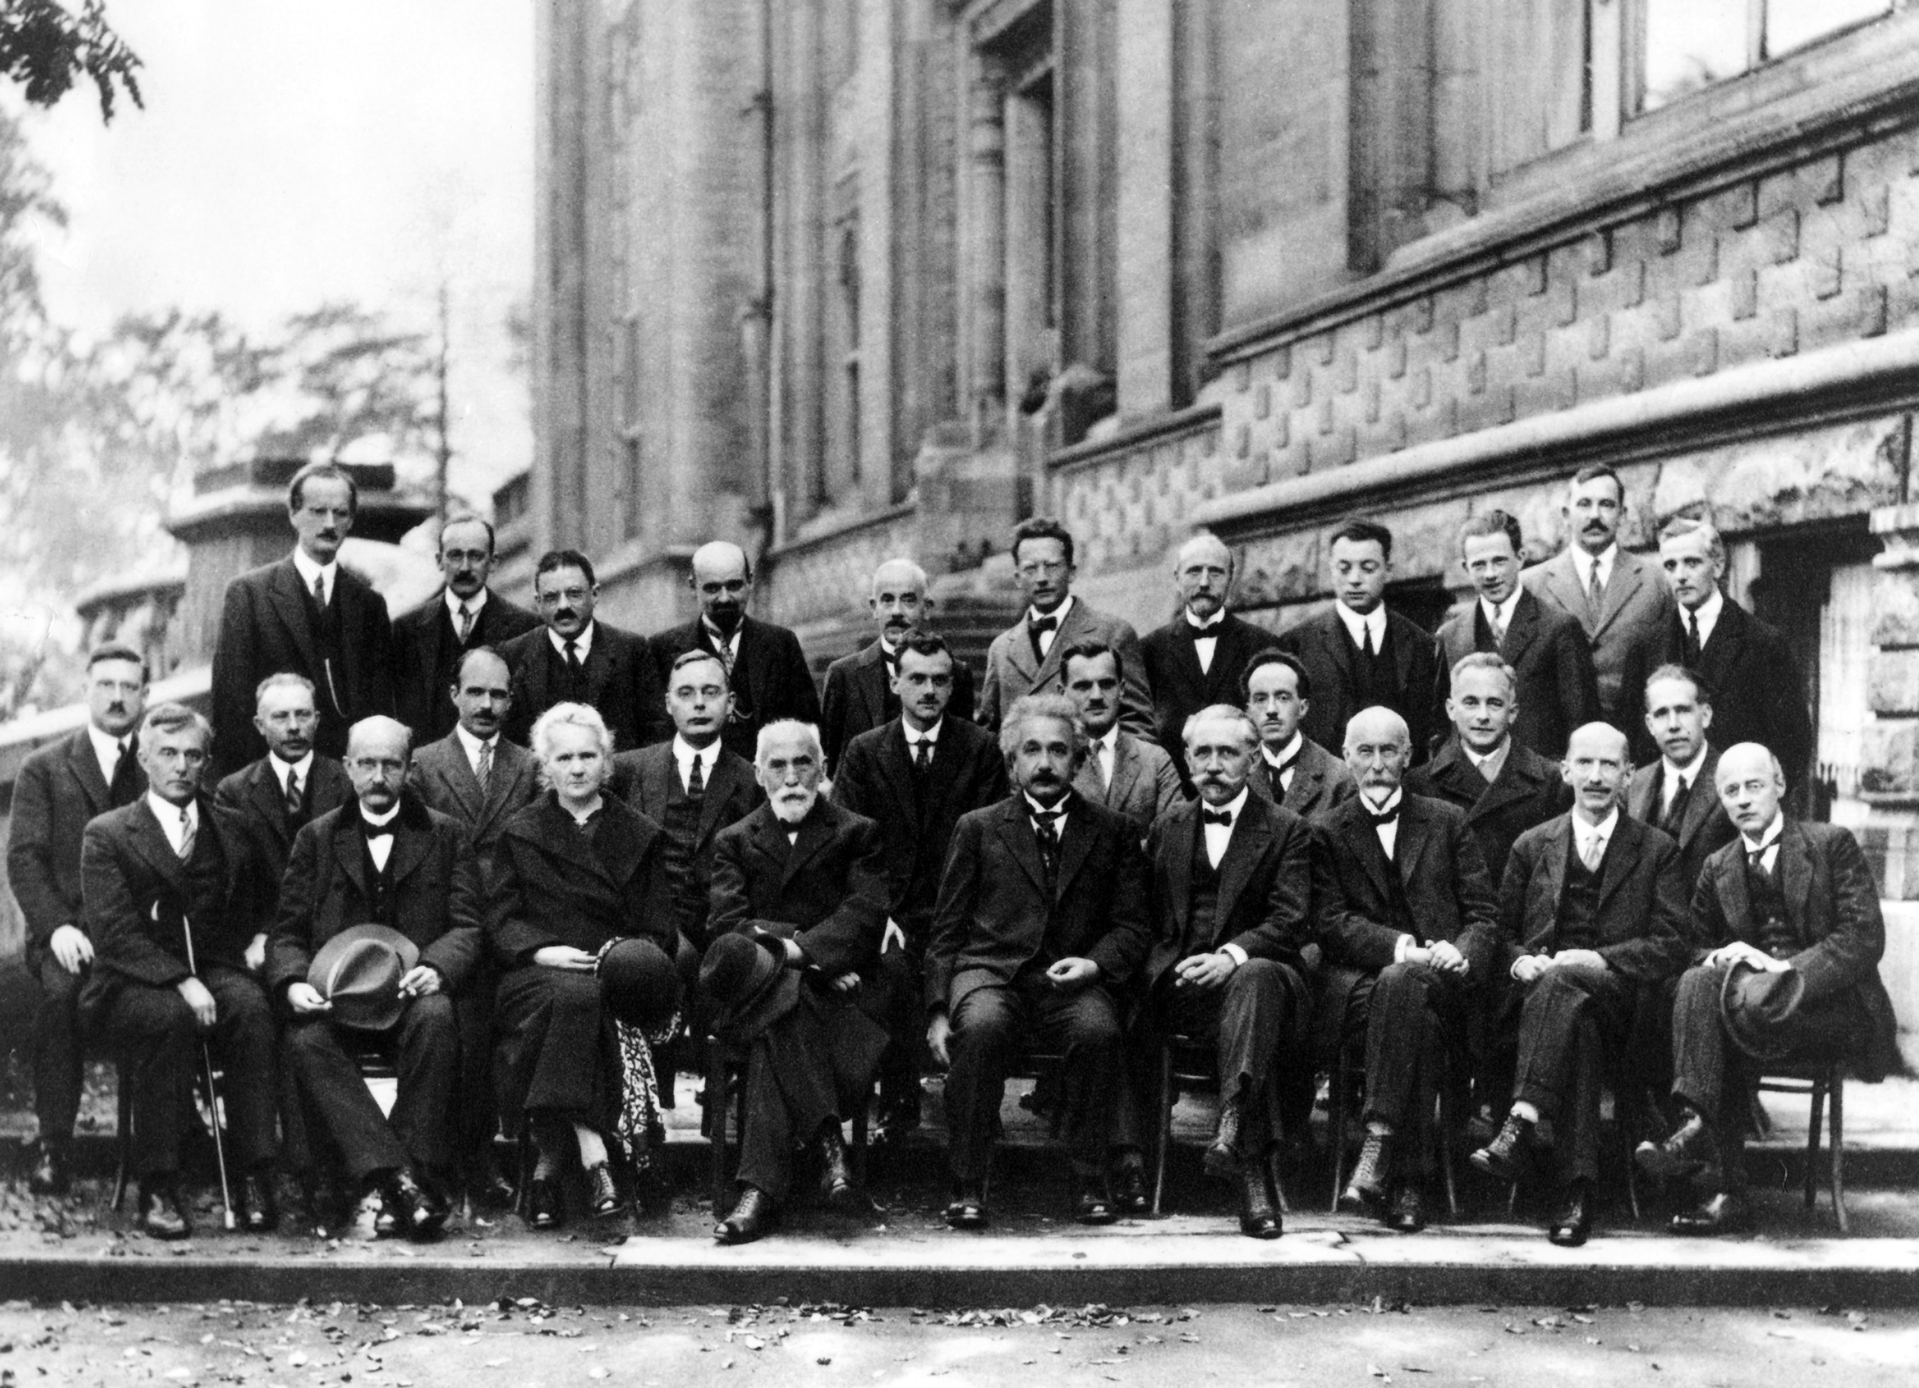
The Solvay conference 1927
Erwin Schrödinger Werner Heisenberg
Paul Dirac
Max Planck
Marie Curie
Albert Einstein
Pic: Wikipedia/Solvay conference
Slide 3/29

Slide 5
Key ingredients of quantum mechanics
Quantum mechanics has certain bizarre features which do not occur in standard, or “classical” physics, such as:
Superposition. If a system can be in state A or state B, it can also be in a “mixture” of the two states. If we measure it, we see either A or B, probabilistically.
Collapse. Any further measurements will give the same result.
Entanglement. There exist systems of multiple parts which cannot be described only in terms of their constituent parts.
Uncertainty. There are pairs of measurements where greater certainty of the outcome of one measurement implies greater uncertainty of the outcome of the other measurement.
The basic idea behind quantum computing is to use these effects to our advantage.
Slide 4/29

Slide 6
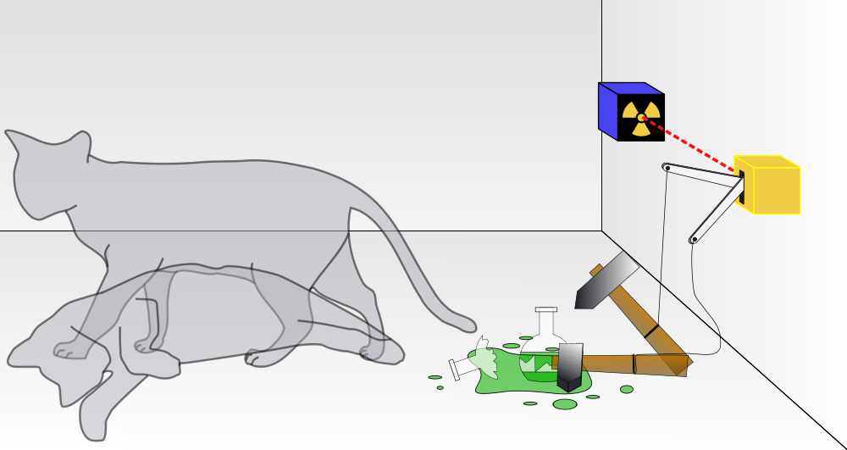
Schrödinger’s cat
Pic: Wikipedia/Schrodinger’s cat
Slide 5/29

Slide 7
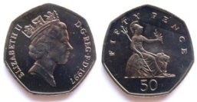


The qubit: the basic building-block of quantum computers
) Quantum mechanics deals with very small systems, like atoms or photons (“particles of light”).
) A quantum system which has two distinct states is called a qubit.
) Just as classical computers operate on bits, quantum computers operate on qubits.
For example, one property of a photon is polarisation: a photon can be either vertically or horizontally polarised (↑ or →), so this gives us a qubit.
vs.
0
1
Pic: coins-of-the-uk.co.uk
Slide 6/29

Slide 8
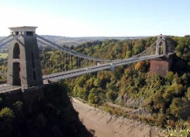


Non-locality and entanglement
Imagine we have a pair of entangled qubits:
Slide 7/29

Slide 9
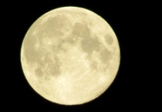
Non-locality and entanglement
) Even if we move one of the qubits to the Moon, the global state of the two qubits cannot be described solely in terms of the individual state of each of them!
) In particular, if we measure one of the qubits, this apparently instantaneously affects the other one.
Slide 7/29

Slide 10
Quantum cryptography
) 1984: Bennett and Brassard propose to use quantum mechanics for secure distribution of cryptographic keys
) 1989: Quantum key distribution demonstrated experimentally
↑ \ 3 ↑ \ \ ↑ →
Alice Bob
) The basic idea is to use the principles of uncertainty and collapse to detect an eavesdropper.
Slide 8/29

Slide 11
Quantum cryptography
) 1984: Bennett and Brassard propose to use quantum mechanics for secure distribution of cryptographic keys
) 1989: Quantum key distribution demonstrated experimentally
↑ \ 3 ↑ \ \ ↑ →
Alice Eve Bob
) The basic idea is to use the principles of uncertainty and collapse to detect an eavesdropper.
) If Eve wants to read Alice’s message to Bob, she has to measure it – and that can be detected.
Slide 8/29

Slide 12
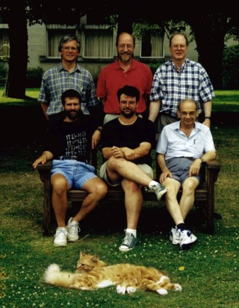
Teleportation: using entanglement to our advantage
) 1993: Quantum teleportation is proposed
) 1997-8: Quantum teleportation demonstrated experimentally
Richard Jozsa, Bill Wootters, Charlie Bennett, Gilles Brassard, Claude Crépeau, Asher Peres,
cat.
Pic: www.cs.mcgill.ca/∼crepeau/tele.html
Slide 9/29

Slide 13



Alice
Bob
The teleportation protocol proceeds as follows:
1. Alice and Bob start by sharing a pair of entangled qubits.
Slide 10/29

Slide 14

m
Alice Bob
The teleportation protocol proceeds as follows:
Alice and Bob start by sharing a pair of entangled qubits.
Alice performs a measurement involving both her half of the pair, and the qubit she wants to send.
Slide 10/29

Slide 15
m
m
Alice Bob
The teleportation protocol proceeds as follows:
Alice and Bob start by sharing a pair of entangled qubits.
Alice performs a measurement involving both her half of the pair, and the qubit she wants to send.
She sends the measurement result m to Bob.
Slide 10/29

Slide 16
m
m
Alice Bob
The teleportation protocol proceeds as follows:
Alice and Bob start by sharing a pair of entangled qubits.
Alice performs a measurement involving both her half of the pair, and the qubit she wants to send.
She sends the measurement result m to Bob.
Bob performs a correction based on the measurement result.
Slide 10/29

Slide 17
m
m
Alice Bob
The teleportation protocol proceeds as follows:
Alice and Bob start by sharing a pair of entangled qubits.
Alice performs a measurement involving both her half of the pair, and the qubit she wants to send.
She sends the measurement result m to Bob.
Bob performs a correction based on the measurement result.
At the end of the protocol, the state of Alice’s qubit has been transferred to Bob’s qubit.
Slide 10/29

Slide 18
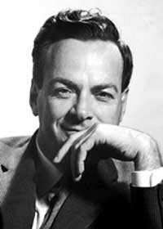
The dawn of quantum computing
There is no efficient general-purpose method known to simulate quantum physics on a standard computer.
) 1982: Nobel Laureate Richard Feynman asked whether quantum physics could be simulated efficiently using a quantum computer.
“If you want to make a simulation of nature, you’d better make it quantum mechanical, and by golly it’s a won- derful problem, because it doesn’t look so easy.”
Pic: Wikipedia/Richard Feynman
Slide 11/29

Slide 19
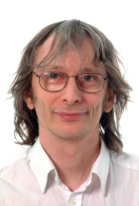
The dawn of quantum computing
But nobody knew what such a quantum computer would look like. . .
) 1985: David Deutsch proposes the mathematical concept of the quantum Turing machine to model quantum computation.
“Computing devices resembling the universal quantum computer can, in principle, be built and would have many remarkable properties not re- producible by any Turing machine.”
Pic: www.physics.ox.ac.uk/al/people/Deutsch.htm
This put the concept of quantum computing on a sound theoretical footing for the first time.
Slide 12/29

Slide 20
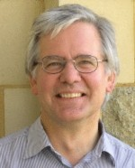
The dawn of quantum computing
But could a quantum computer actually outperform a classical computer?
) 1992: David Deutsch and Richard Jozsa give the first such example.
“The quantum computation solves the problem with certainty in expo- nentially less time than any classical deterministic computation.”
Pic: www.damtp.cam.ac.uk/people/r.jozsa
) 1993: Ethan Bernstein and Umesh Vazirani show that quantum computers can be significantly faster than classical computers, even if the classical computer is allowed a small probability of error.
) 1994: Dan Simon shows that quantum computers can be exponentially faster.
Slide 13/29

Slide 21
The dawn of quantum computing
But could a quantum computer actually outperform a classical computer?
) 1992: David Deutsch and Richard Jozsa give the first such example.
“The quantum computation solves the problem with certainty in expo- nentially less time than any classical deterministic computation.”
Pic: www.damtp.cam.ac.uk/people/r.jozsa
) 1993: Ethan Bernstein and Umesh Vazirani show that quantum computers can be significantly faster than classical computers, even if the classical computer is allowed a small probability of error.
) 1994: Dan Simon shows that quantum computers can be exponentially faster.
These problems were all somewhat contrived. . .
Slide 13/29

Slide 22
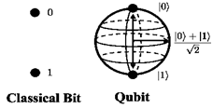
Principles of Quantum Information
Classical information can be measured in the form of binary bits 0 or 1 but Quantum information can be measured in the form of Qubits, Qubit is a superposition of both 0 and 1.
Quantum State |ψ〉= α|0〉+ β|1〉
In general, superposition is represented with the Bloch Sphere as in figure

Slide 23
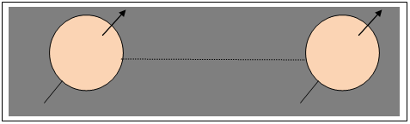
Principles of Quantum Information contd..
Quantum Entanglement is a special property of a Quantum particle. According to the Quantum mechanical principles, a pair or group of particles are generated with similar properties
Quantum Teleportation is a process of transmitting Quantum information from one place to another.
Fig2: Quantum Entanglement

Slide 24
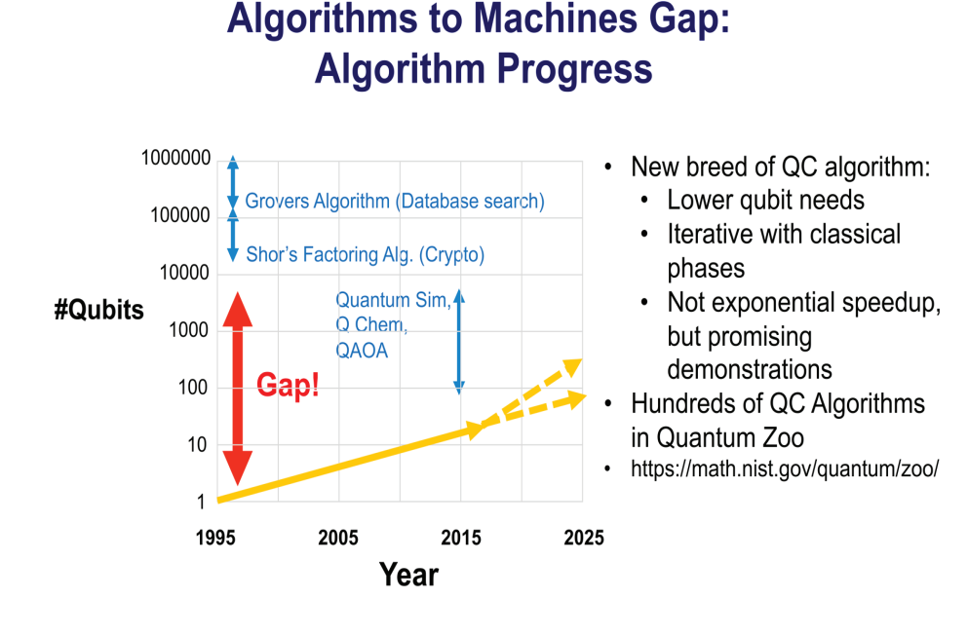

Slide 25
Information Theory
Quantum information theory deals with four main topics:
Transmission of classical information over quantum channels.
The tradeoff between acquisition of information about a quantum state and disturbance of the state (briefly included in quantum cryptography).
Quantifying quantum entanglement.
Transmission of quantum information over quantum channels.

Slide 26
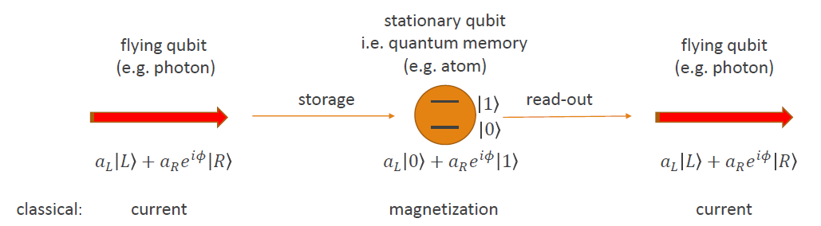
Quantum Memory

Slide 27
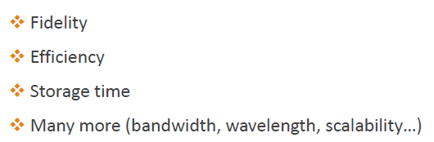
Performance

Slide 28
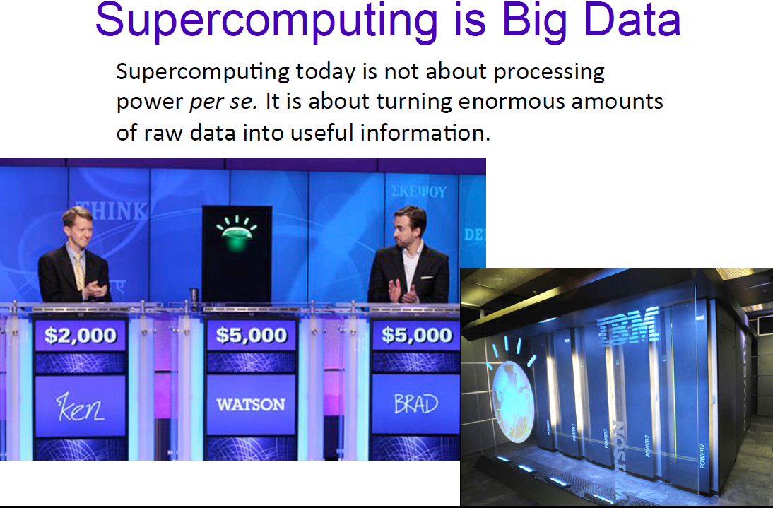

Slide 29
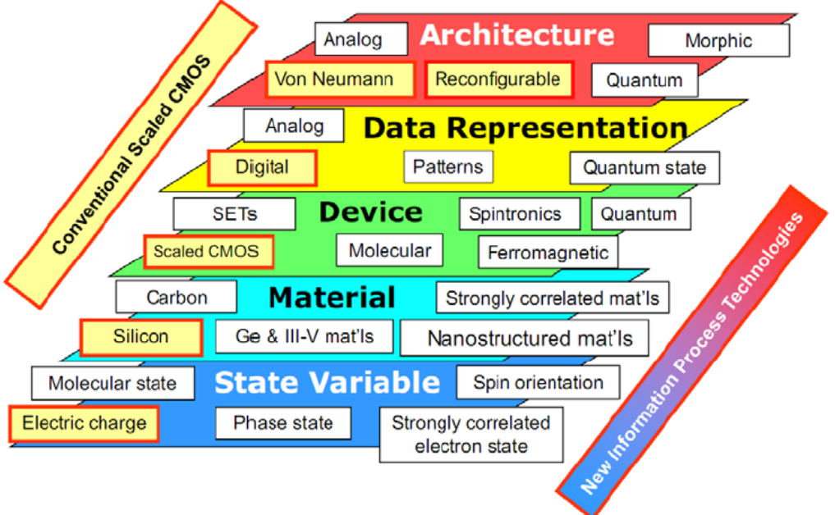
Nano Information processing Technologies

Slide 30
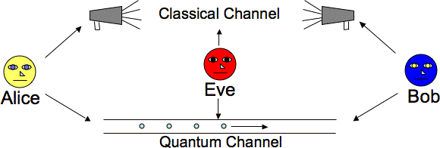
Quantum Cryptography
Quantum cryptography is the science of exploiting quantum mechanical properties to perform cryptographic tasks. The best known example of quantum cryptography is quantum key distribution which offers an information- secure solution to the key exchange problem.

Slide 31
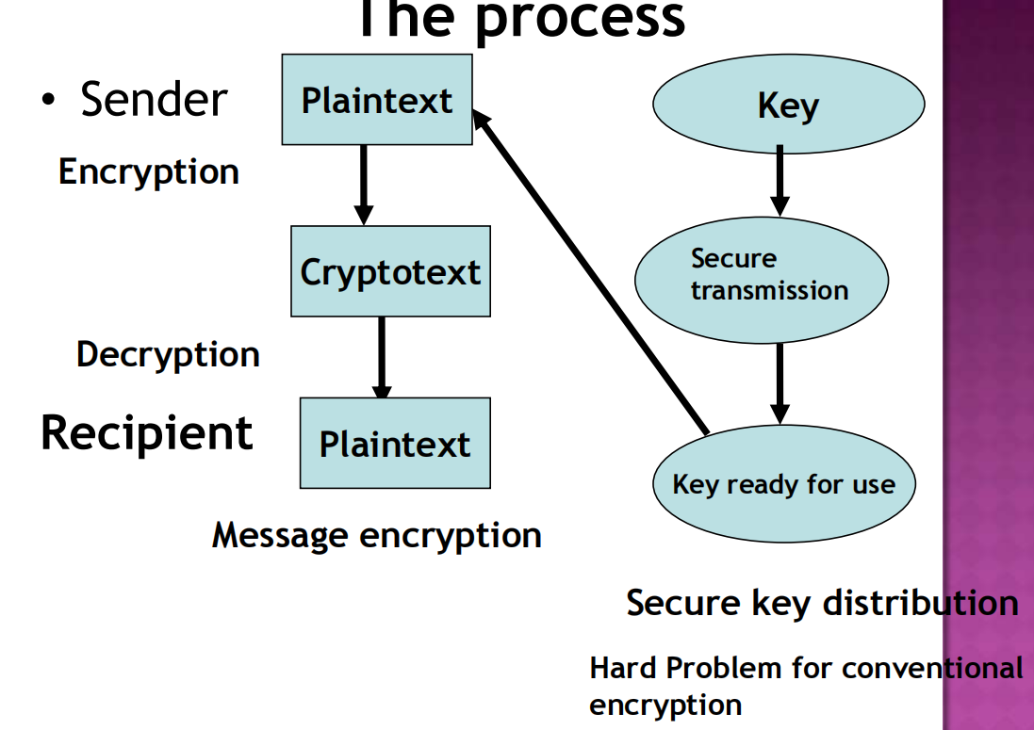

Slide 32
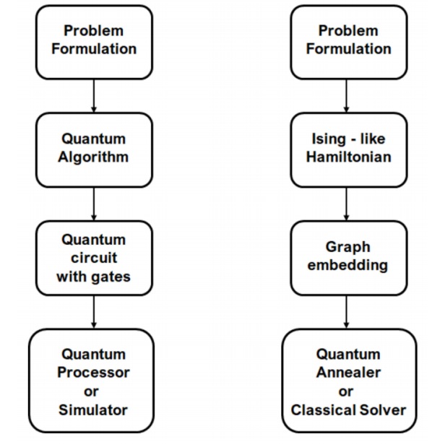
Quantum algorithms workflows: on a gate-model computer (left), on a on a quantum annealer (right)

Slide 33
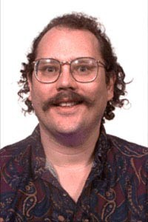
Shor’s algorithm
But could a quantum computer solve a problem which people actually care about?
) 1994: Peter Shor shows that quantum computers can factorise large integers efficiently.
Pic: physik.uni-graz.at
Given an integer N = p × q for prime
numbers p and q, Shor’s algorithm outputs p and q.
No efficient classical algorithm for this task is known.
Shor’s algorithm breaks the RSA public-key cryptosystem on which Internet security is based.
Slide 14/29

Slide 34
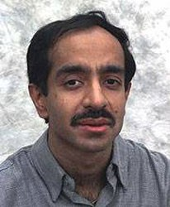
Grover’s algorithm
One of the most basic problems in computer science: unstructured search.
) Imagine we have n boxes, each containing a 0 or a 1. We can look inside a box at a cost of one query.
0 0 1 0 0 0 1 0
) We want to find a box containing a 1. On a classical computer, this task could require n queries in the worst case.
) 1996: Lov Grover gives a quantum algorithm which solves this
problem using about n queries.
√
Pic: Bell Labs
The square-root speedup of Grover’s algorithm finds many applications to search and optimisation problems.
Slide 15/29

Slide 35
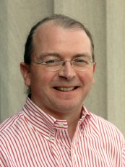
Quantum simulation
The third important algorithmic development in the late 90’s was the resolution of Feynman’s conjecture.
) 1996: Seth Lloyd proposed a quantum algorithm which can simulate quantum-mechanical systems.
“A quantum computer with a few tens of quantum bits could perform in a few tens of steps simulations that would require Avo- gadro’s number [6 × 10²³] of memory sites and operations on a classical computer.”
Pic: MIT
Simulating quantum mechanics has applications to drug design, materials science, high-energy physics, . . .
Slide 16/29

Slide 36
But can we actually build one?
Building a large-scale quantum computer is extremely challenging because of decoherence.
If a quantum computer interacts with the outside world and is subject to noise, it can lose its “quantumness” and behave like a classical computer.
) 1995-6: Peter Shor and Andrew Steane devise quantum
error-correcting codes which can be used to fight decoherence.
The most optimistic current estimates are that a fault-tolerant quantum computer could be built from components which have an error rate of up to about 1%.
Slide 18/29

Slide 37
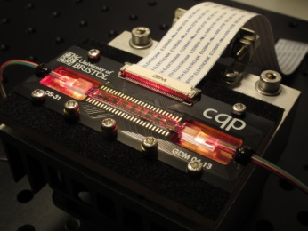
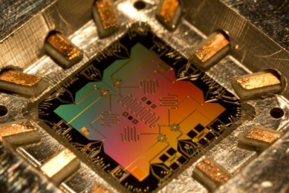
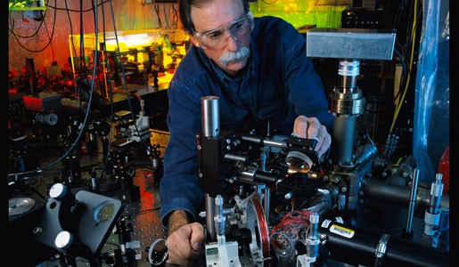
Quantum computing technologies
It isn’t clear yet which technology will be used to build a large-scale quantum computer. Some examples:
Photonic circuits
Superconducting electronics
Trapped ions
Pics: University of Bristol, UCSB, NIST

Slide 38
Some experimental progress
1997-8 | Quantum teleportation demonstrated [Innsbruck, Rome, Caltech, . . . ]
1998 | Quantum error-correction demonstrated [MIT]
2001 | Shor’s algorithm factorises 15 = 3 × 5 using NMR [IBM]
2005 | 8 qubits controlled in ion trap [Innsbruck]
2008 | Photonic waveguide quantum circuits demonstrated [Bristol]
2010 | Entangled states of 14 qubits created in ion trap [Innsbruck]
2012 | 21 = 3 × 7 factorised using quantum optics [Bristol]
2012 | 100µs coherence for superconducting electronic qubits [IBM]
2013 | First publicly-accessible “quantum cloud” [Bristol]
2014 | Superconducting qubits at fault-tolerant threshold [UCSB]

Slide 39
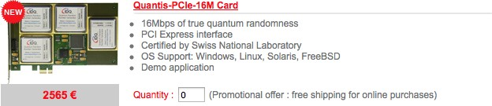
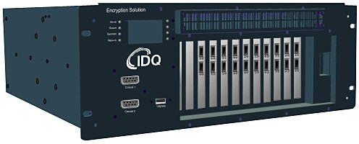
Quantum technologies you can buy today
Quantum random number generators:
Quantum key distribution solutions:
Both of these products marketed by ID Quantique.
Slide 21/29

Slide 40
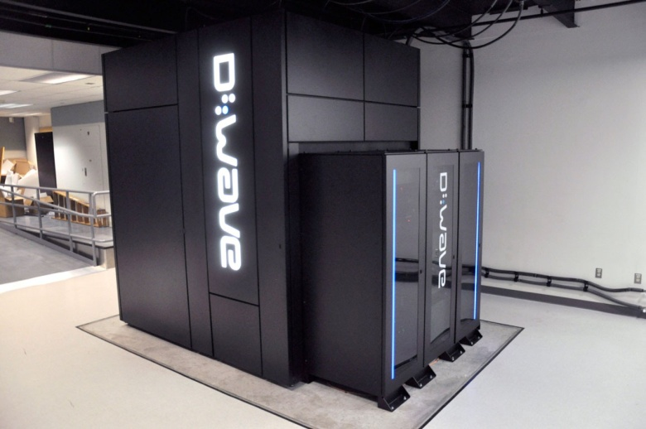
Quantum technologies you can buy today
The D-Wave Two “quantum computer”:
Pic: NASA

Slide 41
The D-Wave Two device
D-Wave Systems, Inc. claims that their system is the world’s first large-scale quantum computer, with up to 512 qubits.
However, their claims are controversial:
) Their machine isn’t a general-purpose quantum computer, but can only be used to run one optimisation algorithm.
) Their qubits are “noisy”, and do not operate below the fault-tolerant threshold.
) They have not demonstrated large-scale quantum entanglement.
) Recent research suggests that fine-tuned classical optimisation algorithms can sometimes outperform their machine.
Characterising the power and potential of the D-Wave approach is currently an active area of research.
Slide 23/29

Slide 42
The commercial future of quantum computing
Can quantum computing make money?
) Several major technology companies now have their own quantum computing research efforts, e.g. IBM, Microsoft (two groups!), Google.
) 2002: ID Quantique is first commercial company to demonstrate quantum key distribution.
) 2013: Mike Lazaridis (founder of BlackBerry) announces $100M venture capital fund to invest in quantum computing.
) 2014: The UK government announces £270M funding for research into, and commercialisation of, quantum technologies.
Estimates (perhaps not reliable) for the value of the quantum computing market are into the 10’s of billions by 2020.
Slide 24/29

Slide 43
Challenges for quantum computing
Although there has been significant progress in quantum computing, the field faces a number of challenges:
) The difficulty of building a large-scale quantum computer;
) The difficulty of designing new quantum algorithms;
) The difficulty of applying existing quantum algorithms to practical problems;
) The difficulty of proving limitations on quantum computers.
So there is still much to be done. . .

Slide 44
Summary
) Quantum computers can solve certain problems more efficiently than classical computers.
) We don’t have large-scale, general-purpose quantum computers yet. . .
) . . . but physicists and engineers are working on it!
) The most important application of a large-scale quantum computer is likely to be simulating quantum-mechanical systems.
) There are still many interesting open questions about the power and potential of quantum computing to be explored.
Slide 26/29

Slide 45
Further reading
) Winning a Game Show with a Quantum Computer Ashley Montanaro
http://www.cs.bris.ac.uk/~montanar/gameshow.pdf
) Quantum Computing Since Democritus Scott Aaronson
http://www.scottaaronson.com/democritus/
) Introduction to Quantum Computing, University of Waterloo John Watrous
https://cs.uwaterloo.ca/~watrous/LectureNotes.html
) Quantum Computation and Quantum Information Michael Nielsen and Isaac Chuang
Cambridge University Press

Slide 46
Partial timeline: Theory of quantum computing
.
.
1984 Quantum cryptographic key distribution invented [Bennett+Brassard]
1985 General quantum computational model proposed [Deutsch]
1992 First exponential quantum speed-up discovered [Deutsch and Jozsa]
1993 Quantum teleportation invented [Bennett et al.]
1994 Shor’s algorithm rewrites the rulebook of classical cryptography 1995 Quantum error-correcting codes invented [Shor]
1996 Quantum simulation algorithm proposed [Lloyd]
1996 Quantum speed-up for unstructured search problems [Grover] 1998 Efficient quantum communication protocols [Buhrman et al.] 2003 Exponential speed-ups by quantum walks invented [Childs et al.]
.
.

Slide 47
The rise of quantum computing
Following the publication of these algorithms, there was an explosion of interest in quantum computing:
2500
2000
1500
1000
500
1980 1985 1990 1995 2000 2005 2010
No. of published papers using phrase “quantum computer” per year (Google Scholar)

Slide 48
Post-Quantum world
There is a good chance that quantum computers will be able to crack RSA-2048 within five-ten years (need about 8,000 qubits in a universal computer to do this).
Some encrypted data has a shelf-life of more than ten years. It may take ten years to cut over to a new encryption scheme, so companies and governments are scrambling to figure out what to do.
Most encryption used today is not safe in a quantum world.
If someone has been recording a https session, say, they may not be able to decrypt it now, but a few years from now, who knows.

Slide 49
There are encryption algorithms that are safe:
Secure communications will move to symmetric encryption or hash algorithms, or perhaps lattice algorithms.
QKD will likely be more popular for the most sensitive communications
Some governments and banks are already starting to use “Quantum Safe” algorithms, and this is expected to increase over the next decade.

Slide 50
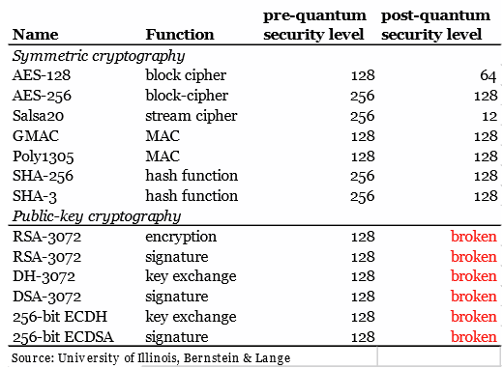
Post-Quantum Algorithm Assessment
Grover’s Algorithm cuts these in 1/2
Shor’s Algorithm blasts these apart

Slide 51
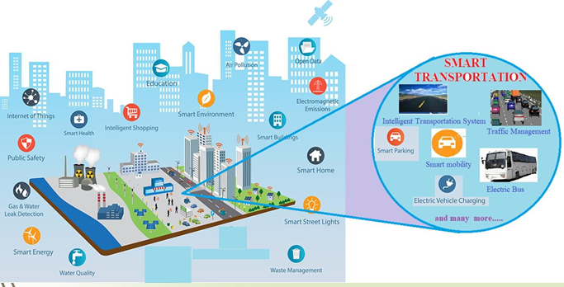
Case Studies 1.Smart Cities

Slide 52
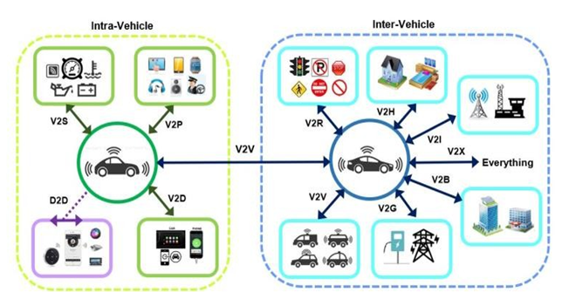
2. Internet of Vehicles

Slide 53
Start thinking post-quantum now
It may take 5-10 years to replace infrastructure & software
It is good advice, I think, to start moving to a post-quantum secure world now.
Here is a good place to start
https://csrc.nist.gov/Projects/Post-Quantum-Cryptography

Slide 54
Challenges
Lower dephasing and decoherence times
More qubit systems: 64, 128, 192, 256.
Non-cryogenic temperature
Much greater connectivity
Much lower error rate
True fault tolerance
Much lower cost

